Slide 1
A sketch of tweets Surya Prakash Sahu

Slide 2
Elements of a tweet
Normal text (may have a meaning or may not)
# trend
where trend is a variable which can take values of trending incidents
@ user_name
where user_name can take values of registered users with twitter

Slide 3
Elements of a tweet
url / video / image
These all can be included as url as twitter first stores them as url and post the link in the tweet.
.
. is used when we address someone specifically.
RT
Is used when retweet someone's tweet.
ENGLISH
Normal English language + Unicode characters

Slide 4
Used inputs (∑ )
.
RT
#
@
U_NAME =user name
TREND
ENGLISH
T (image / video /url)
є

Slide 5
ENGLISH !!??
Here ENGLISH means the CFG for English language.
A rough estimation
ENGLISH -> NP VP
PP -> P NP
NP -> DET N | DET N PP
VP -> V NP|VP PP
DET -> determinants | Unicode
PP ->preposition phase | Unicode
NP ->noun phase | Unicode
VP ->verb phase | Unicode
N -> noun | Unicode
V ->verb | Unicode

Slide 6
TRANSITIONS(δ)
 | RT | @ | U_NAME | # | TREND | ENGLISH | T | Є-CLOSURE
0 | 1 |  |  |  |  |  |  | 0,1,3,4
1 |  | 2
2 |  |  | 3
3 |  |  |  |  |  | 4
4 | 1 | 5 |  | 7 |  | 4 | 6
5 |  |  | 6
6 |  | 5 |  | 7 |  | 4 | 6
7 |  |  |  |  | 4

Slide 7
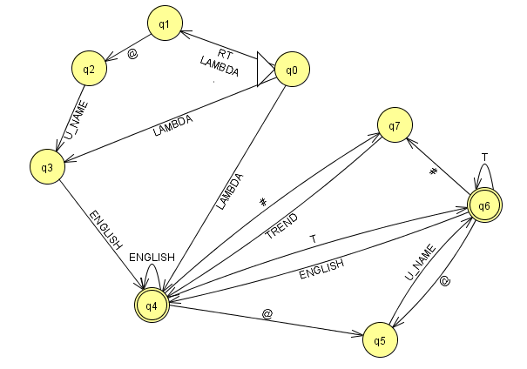
Starting with NFA-є

Slide 8
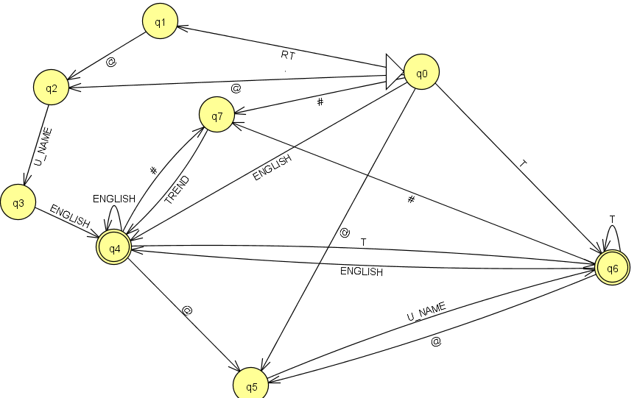
Corresponding NFA

Slide 9
Thanks…

